Slide 1

Windows 11 Installation
PLEASE CONTACT The windows coders discord or
Gabriel johnson with bugs or issues
Welcome to windows.
Join our discord

Slide 2
Windows 11
Slides edition
Start Installation

Slide 3
WINDOWS 11 Installation
Language - english (us)
Keyboard version - us (qwerty)
Operating System - Windows 11 Slides Edition
Install windows

Slide 4
WINDOWS 11 Installation
Installing Windows
Press Right Arrow

Slide 5
Windows 11
IS NOW INSTALLED
ENJOY WINDOWS

Slide 6




Credits

Slide 7


SEarch
Chrome
salty

Slide 8
Are you sure you would like to power down?
Press the power button for yes, and windows for no

Slide 9
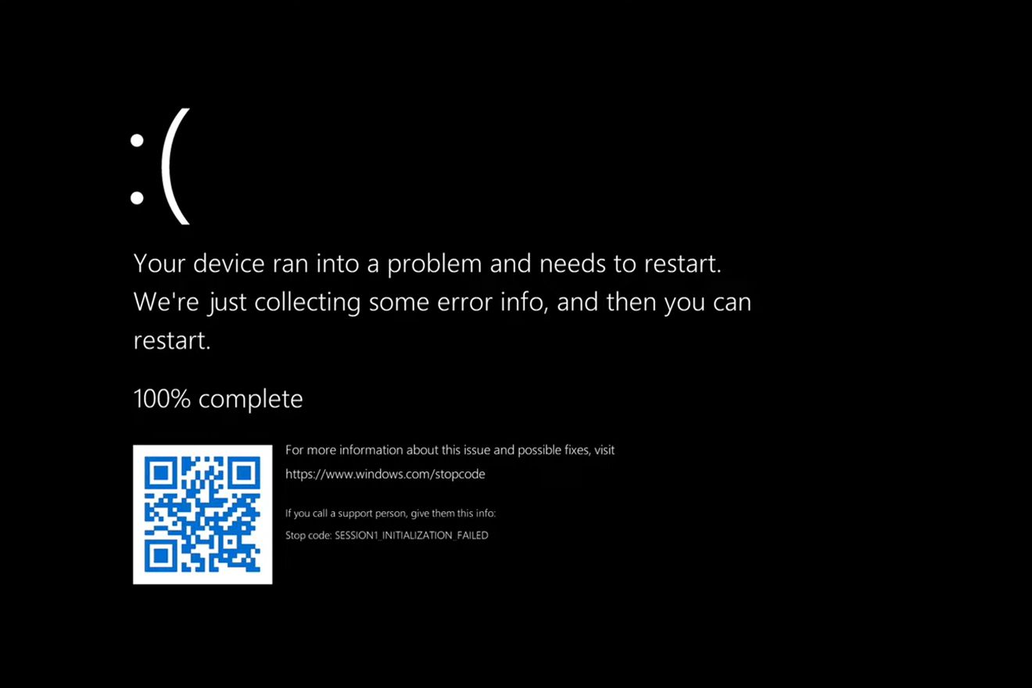
Retry?

Slide 10

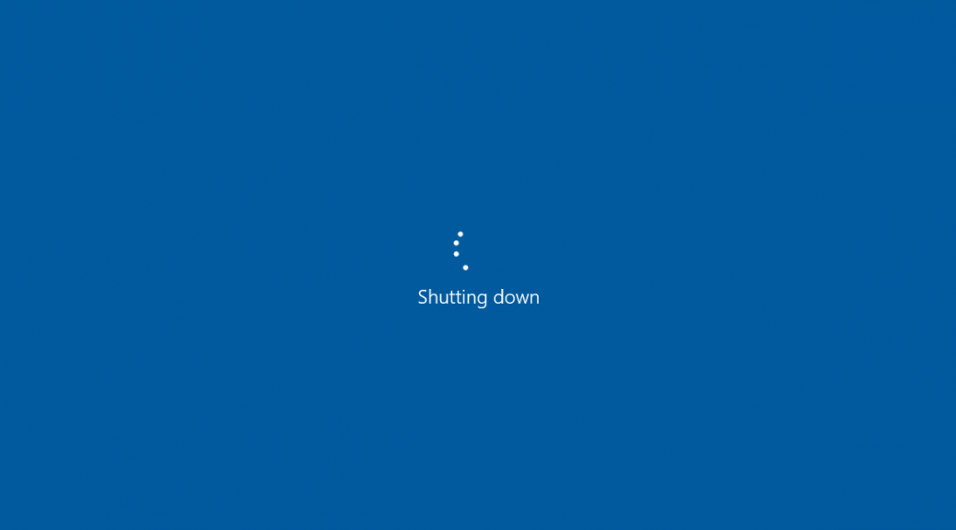

Slide 11
Windows 11
:(
CAnnot boot, please reinstall.
Start Installation

Slide 12
PRESS HERE FOR CHROME
PRESS HERE TO GO BACK

Slide 13
Credits
Gabriel johnson for initial design
Maximus stanley for design edits
Windows for original operating system
Google slides for software
Hms, this was made for you. Welcome to windows.

